Slide 1
ENTK Exercises

Slide 2
Objectives
Learn ENTK
  Tasks, Stages, & pipeline.
  How to establish dependency between tasks through the PST model
Implement ENTK to a HPC machine (Stampede2 and comet)
Learn Radical Analystics

Slide 3
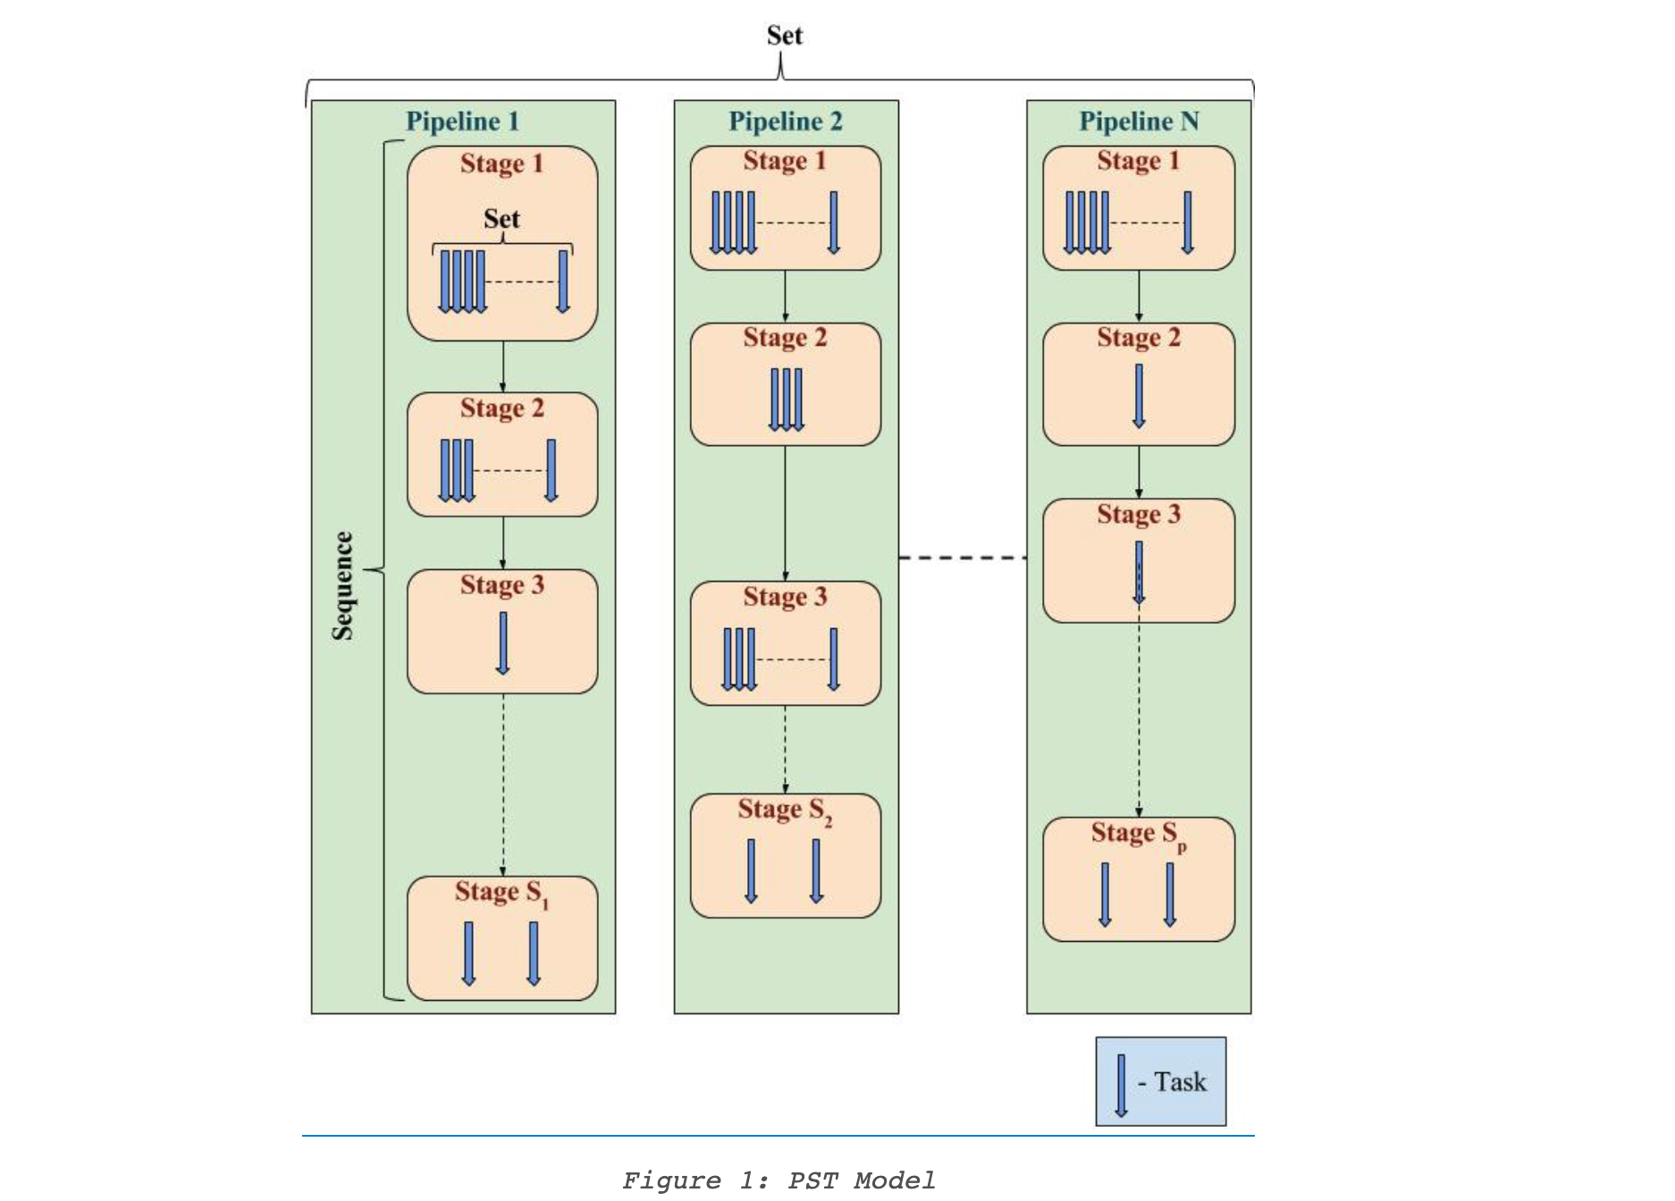
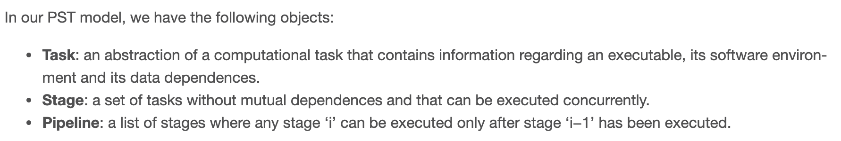
Important concepts: PST MODEL
Notes:
What I understood was:
1. In one stage, all the task are running concurrently
2. In one pipeline, different stages works in a temporal behaviour. Stage 1 executes before stage2
3. 1 batch == 1 stage. Therefore, different batches mean different stages. If different batches are to be run concurrently, then you create more than 1 pipeline.

Slide 4
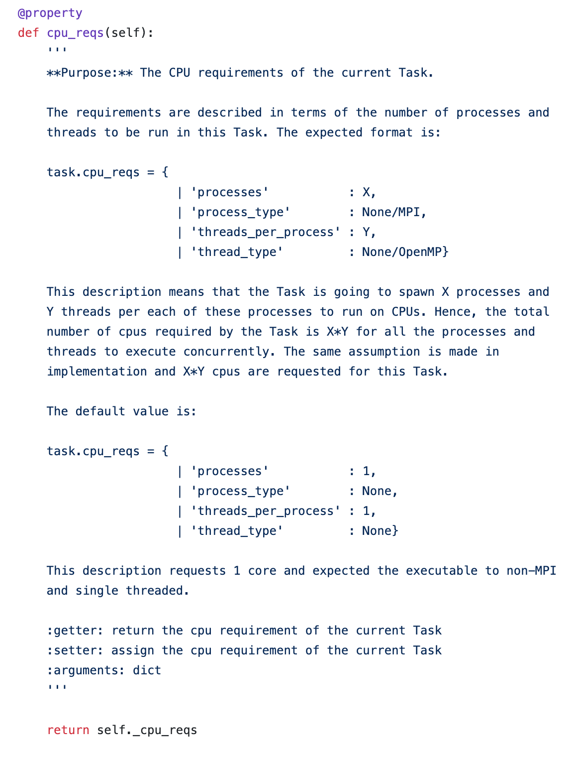
Task Attributes

Slide 5
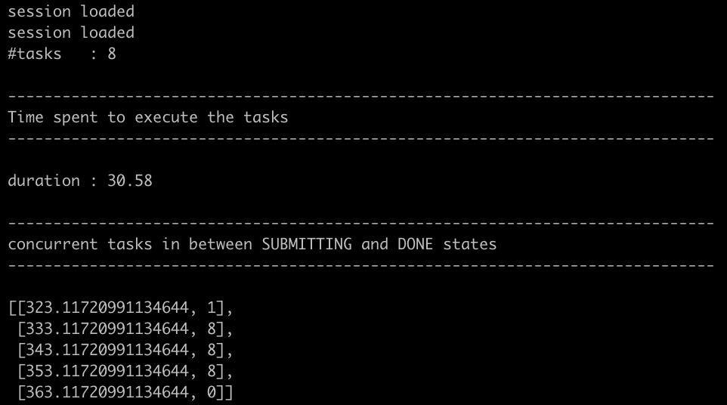
Ques1. 128 8 tasks concurrently, where each task is 1 core
8 tasks concurrently with each task taking 1 core each
Resource: Stampede2 (1 node = 68 cores)
Queue: Normal
Executable: /bin/sleep with arguments 2s
Radical Analytics —>
*changed the number of cores/tasks because of the limit
On the limit on stamepde2(ticket already generated #416)
Also, tried working on comet, but comet had an error
(again, ticket generated for it #419)
[Time stamp, number of cores running]

Slide 6
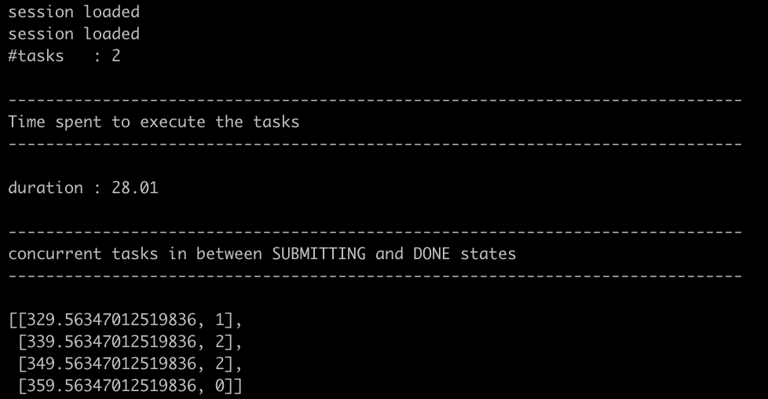
Ques2. 8 2 tasks where each task is 16 4 cores
2 tasks concurrently with each task taking 4 cores each
Resource: Stampede2 (1 node = 68 cores)
Queue: Normal
Executable: /bin/sleep with arguments 2s
Session lifetime: 495.7s
Radical Analytics —>

Slide 7

Ques2.16 concurrent batches of 8 tasks (each of 1 core), but where in each batch each task runs sequentially, i.e., one after the other.
16 concurrent batches means 16 pipelines with 1 stage, each stage requiring 8 tasks, and each task require 1 core.
4 concurrent batches with 2 tasks each, each task taking 1 core
(4 pipelines with 1 stage ach, having 2 tasks in each stage)
session lifetime: 513.0s
Radical-analytics—>

Slide 8
Doubts/Further Studies
bin/stress-ng
synapse

